Slide 1

Vivekanand Education Society’s Institute Of Technology
Department Of Information Technology
Project Review
Title: Movie Recommendation
System
Domain: Machine Learning
Group Members:
Member 1: Nandana Nair(48)
Member 2: Prajwal Patil(52)
Member 3: Sakshi Patil(53)
Sem VI Academic Year : 2022-23
Mentor Name: Bincy Ivin

Slide 2
Content
Introduction
Problem Statement
Objective of the project
Literature Survey
Functionalities
Dataset selected
Requirements of the system (Hardware, software)
Block diagram
References

Slide 3
Introduction
Movie Recommendation System helps user by suggesting them movies based on the genre of their choice.
Movie Recommendation Systems uses content-based filtering to recommend movies that are similar in genre, plot, and theme to the movies that the user has enjoyed in the past.
Provides personalized and enjoyable movies to enhance the overall movie-watching experience.

Slide 4
Problem Statement
Despite the availability of a vast array of movie genres and subgenres, users often struggle to find movies that match their preferred genres and interests. Existing movie recommendation systems may not always provide accurate and diverse recommendations, leading to user dissatisfaction and disengagement. A genre-based movie recommendation system can address this problem by providing users with personalized movie recommendations based on their preferred movie genres which will make their movie watching experience a good one.

Slide 5
Objectives of the Project
To provide users with personalized movie recommendations based on their preferred movie genres.
To identify the user's specific sub-genre and thematic preferences within their preferred genres.
To enhance the overall movie-watching experience for users by providing them with personalized and enjoyable movie recommendations that match their interests.
To increase user engagement and retention by providing accurate and diverse movie recommendations that keep users interested and satisfied.

Slide 6
Literature Survey
Name of the paper | Publication | Methods | Merits | Demerits
A Movie Recommender System: MOVREC using Machine Learning Techniques | Ashrita Kashyap1 , Sunita. B2 , Sneh Srivastava3 , Aishwarya. PH4 , Anup Jung Shah5 Department of Computer Science & Engineering SAIT, Bengaluru, Karnataka, India | collaborative filtering algorithm | Create a personalized recommendation list | No web based user interface

Slide 7
Literature Survey
Name of the reference | Publication | Methods | Merits | Demerits
MOVIE RECOMMENDATION SYSTEM BASED ON WEB DATA MINING APPROACH | B.PREMKUMAR (2015246013) | Content-based,Collaborative-based,hybrid | Recommendation based on user’s past history | -

Slide 8
Functionalities
The user can see the Latest and Top rated movie on the Home Page
The user will be allowed to select a movie from the available list of movies.
The the user will select the number of movies to be recommended which ranges from 5-25.
Further user will select the sort order as Ascending or Descending for IMDB ratings.
The user will be recommended with a list of movies based on the genre of the selected movie.

Slide 9
Dataset selected
Columns in the Dataset
ID
Title
Genre
Original Language
Overview
Popularity
Production Companies
Release Date
Budget
Revenue
Runtime
Status
Tagline
Vote Average
Vote Count
Credits
Keywords
Poster Path
Backdrop Path
Recommendations
Dataset Link: https://www.kaggle.com/datasets/akshaypawar7/millions-of-movies
It contains metadata for more than 700,000 movies listed in the TMDB Dataset.
Each file contains anywhere from around 9000 to 26000 rows and 20 columns.
There are around 186851 data points combining all the 12-month files. There may be null values in some rows.

Slide 10
Requirements of the system
(Hardware, software)
Hardware: Laptop - processor i5, 7th generation.
Software:
# Frontend
-> Streamlit
# Backend
-> Python
# Machine Learning Algorithm.
-> Cosine similarity
# Others
-> V.S. Code (IDE)
# Version control
-> Git
-> Github

Slide 11
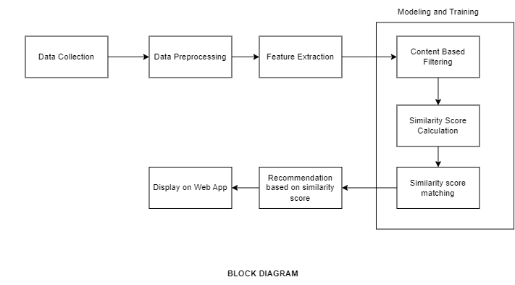
Block Diagram

Slide 12
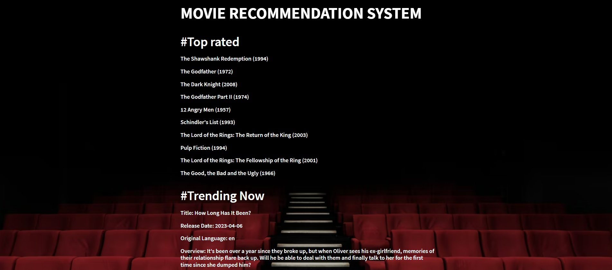
Screenshots
HOMEPAGE

Slide 13
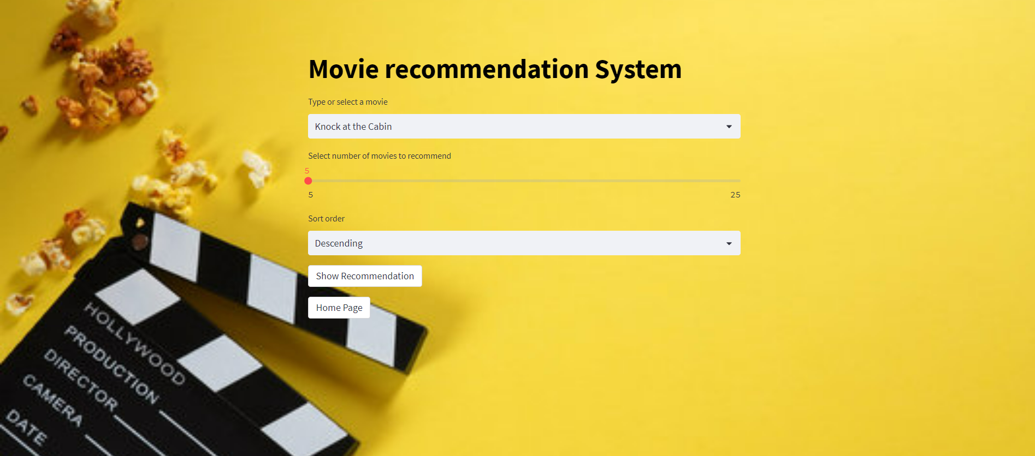
Recommendations Page

Slide 14
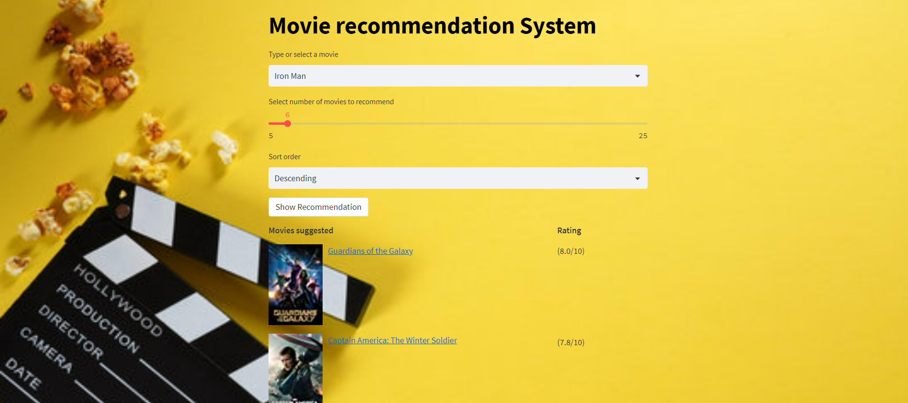

Slide 15


Slide 16
Future Scope
One potential improvement would be to incorporate user ratings and preferences into the recommendation algorithm. This could involve using collaborative filtering techniques, where the system learns from the user's past ratings and recommends movies that other users with similar tastes have enjoyed. Another possible direction would be to explore the use of deep learning techniques such as neural networks to extract more complex features from the movie descriptions and improve the accuracy of the similarity scores.

Slide 17
References
[1]https://www.analyticsvidhya.com/blog/2020/11/create-your-own-movie-movie-recommendation-system/
[2]https://medium.com/web-mining-is688-spring-2021/content-based-movie-recommendation-system-72f122641eab#:~:text=Content%20Based%20Recommendation%20System%3A%20It,a%20show%20similar%20to%20it
[3]https://www.youtube.com/watch?v=1xtrIEwY_zY
[4]https://www.youtube.com/watch?v=Dw9_BQ60ERU
[5]Content Based Movie Recommendation System by N Pradeep

Slide 18
Conclusion
In this project, we have developed a movie recommendation system using content-based filtering techniques. The system is able to suggest a list of similar movies based on the user's input of a movie title. We have used a dataset of more than 7 lakh movies. We first used the IMDbPY library to retrieve movie details and ratings from IMDb. Then we used natural language processing techniques to extract relevant features from the movie descriptions and calculate the similarity between movies. Finally, we used this similarity matrix to recommend movies based on the user's input.
It will be able to sort the results in ascending or descending order on the basis of ratings from IMDB. The movies will also have hyperlinks to its respective reviews on IMDB.

